Slide 1
Business Understanding and Analytical Plan
AegisLife Insurance | Step 1
Core business challenges
Analytical goals
Rising claim cost: 127.4M approved claims vs 75.5M premium (loss ratio 169%)
Possible fraud and leakage: 49% of claims flagged; 266 exceed policy cover
High lapse: 66% of policies are not active
Inconsistent data across five source tables
No single dashboard for decision-makers
Find the regions, products and customers that drive losses
Test whether risk, age, smoking or region explain claims
Identify agents with high lapse or fraud association
Build executive and regional dashboards for monitoring
Core KPIs
Hypotheses to test
KPI | Definition
Loss Ratio | Approved claims / annual premium
Claim Frequency | Claims / policies
Agent Productivity | Policies sold per agent
Policy Lapse Rate | Non-active / all policies
Also tracked | Approval rate, avg claim, fraud ratio
H1: High-risk customers have a higher loss ratio than Low-risk
H2: Smokers claim more often than non-smokers
H3: Claim size differs by region, product and age band
H4: Agents with high lapse also have higher fraud association
H5: Death claims have a higher fraud-flag rate than other types

Slide 2
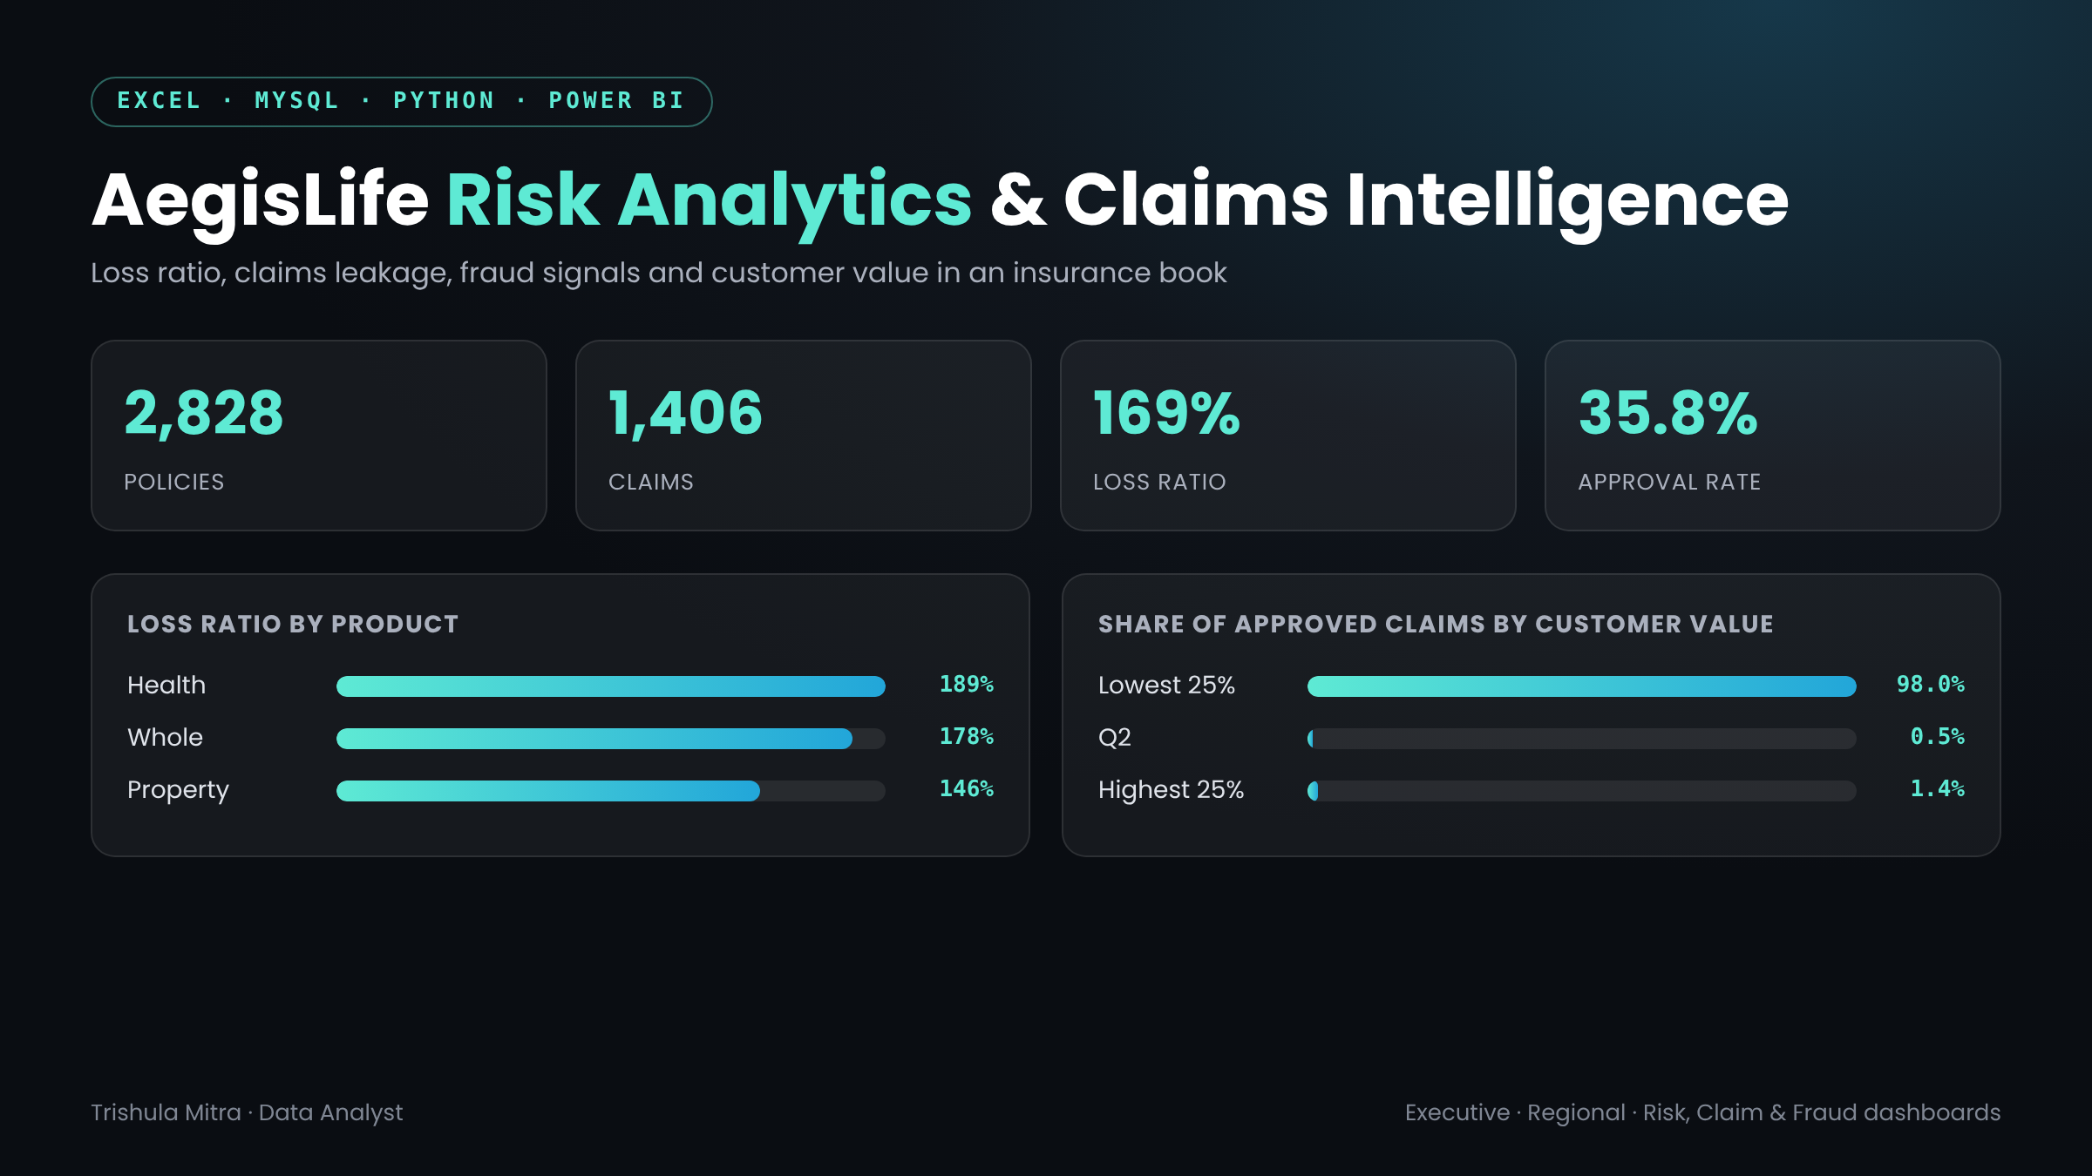

Slide 3
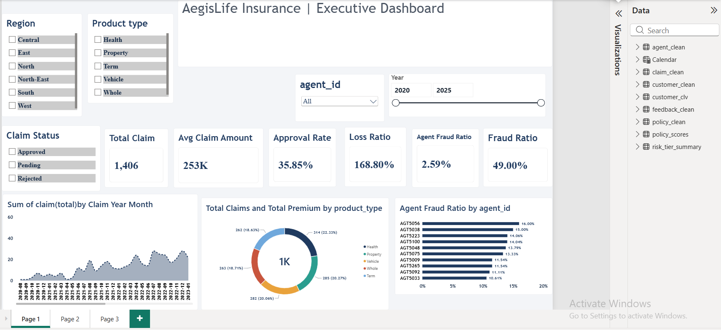

Slide 4
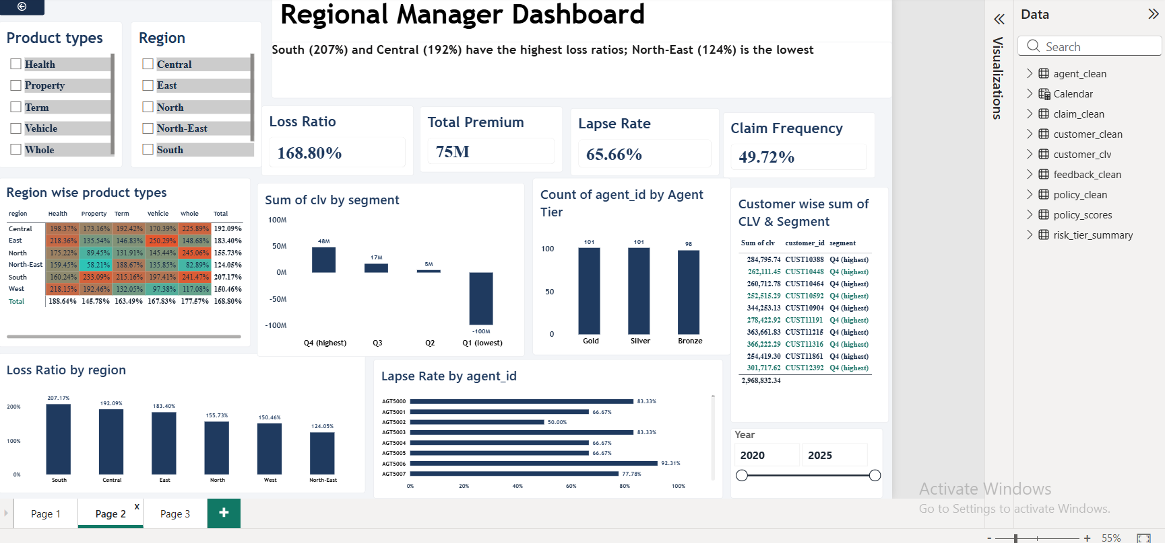

Slide 5


